Slide 1



Finance and Risk Analytics – Capstone Project
Presenters
Rachin Salim
ShivaKumar Dwarapogu

Slide 2
Agenda
Objective
Background
Key Insights
Portfolio Analysis
Methodology

Slide 3
Objective
To provide tailored investment consultation to Mr. Patrick Jyenger and Mr. Peter Jyenger, aligning with their unique financial objectives and risk tolerances, in order to optimize their portfolio performance and achieve their long-term financial goals.

Slide 4

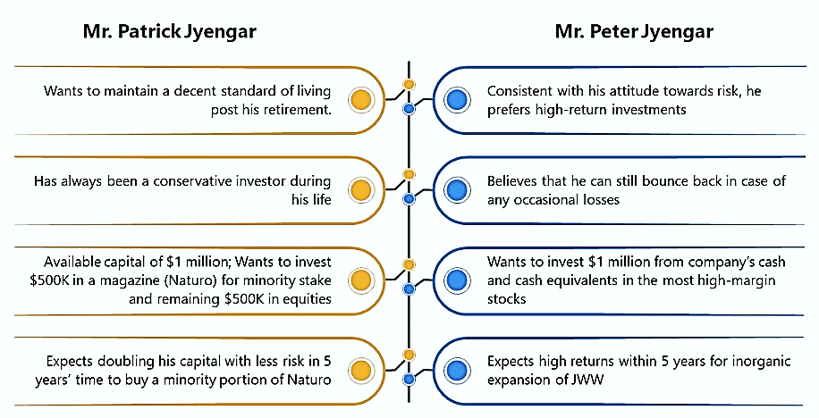

Background
Financial
goals

Slide 5

Key Insights

Slide 6
Stocks Data
Conduct detailed analysis of 24 individual stocks spanning from October 1st, 2010 to September 30th, 2020.
Leveraging 5 years of data for analysis from October 1st, 2015 to September 30th, 2020.
Utilize closing price data for technical analysis.
Categorize stocks into five distinct industries: aviation, finance, healthcare, pharmaceuticals, and technology.
Formulate personalized investment recommendations tailored to clients Mr. Patrick Jyenger and Mr. Peter Jyenger.
Ensure alignment of investment recommendations with clients' financial objectives and risk profiles.
Aim for optimal portfolio performance through strategic alignment with industry-specific trends and market dynamics.

Slide 7
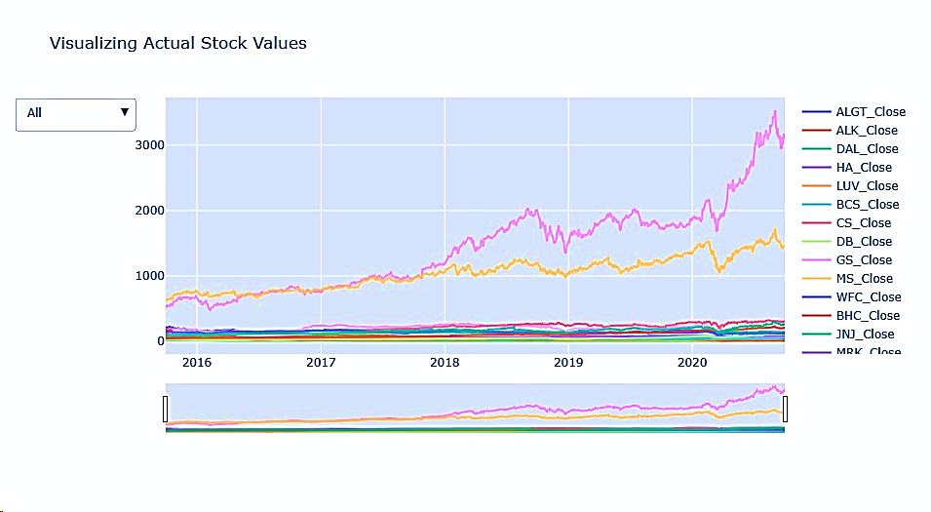
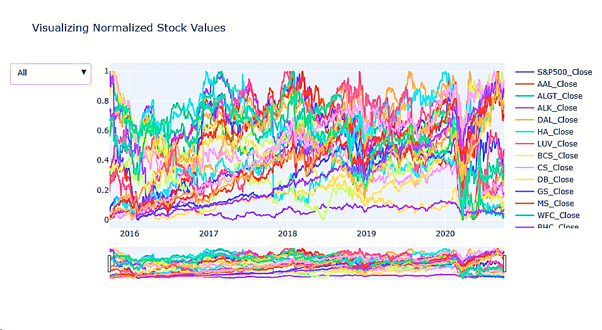
Actual stocks VS Normalized stocks
Actual stocks Values
Visual representation of unnormalized stock data lacks clarity and inhibits insight generation.
Normalized Stocks Values
This visualization presents the normalized data, achieved through MinMax scaler normalization, to facilitate comprehensive analysis and further insights.

Slide 8
DOMAINS ANALYSIS

Slide 9
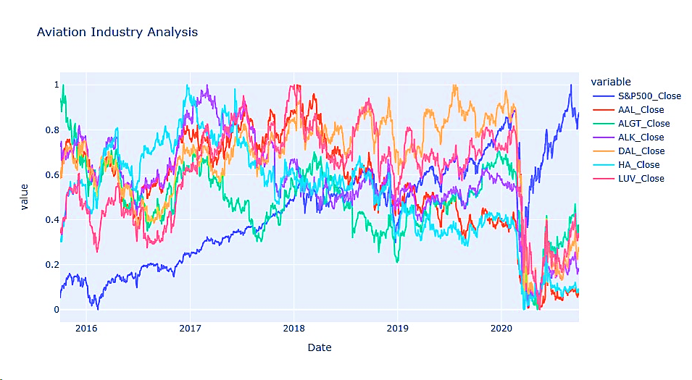
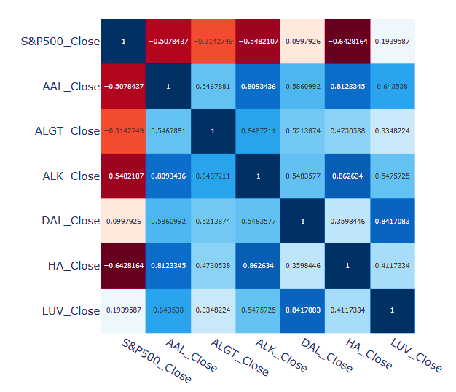
AVIATION INDUSTRY ANALYSIS
The aviation sector faced a notable crisis in March 2020 amid the Coronavirus pandemic, exhibiting a slow recovery despite subsequent market index increases.
Analysis suggests that stocks AAL, ALGT, ALK, and HA are negatively correlated with the market index.
Additionally, HA and ALK demonstrate the highest positive correlation among the stocks examined.

Slide 10
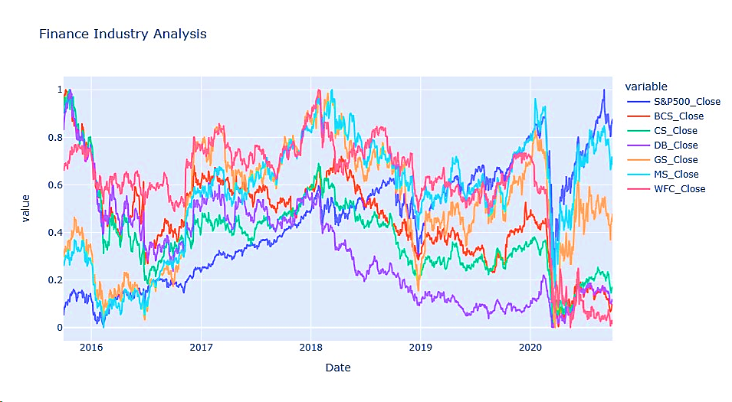
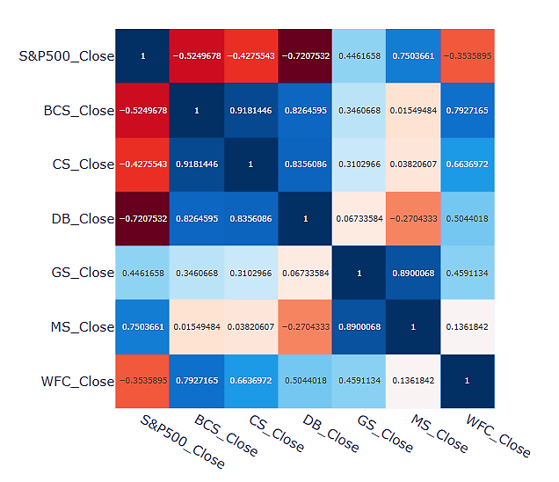
FINANCE INDUSTRY ANALYSIS
The finance sector faced challenges during the March 2020 Coronavirus pandemic outbreak, with subsequent signs of recovery despite significant impacts on several stocks within the sector.
Notably, Morgan Stanley and Goldman Sachs displayed relatively robust performance compared to other finance sector stocks, exhibiting a positive correlation with the market index.
Analysis indicates a high correlation between Morgan Stanley and Goldman Sachs compared to other stocks in the sector.

Slide 11
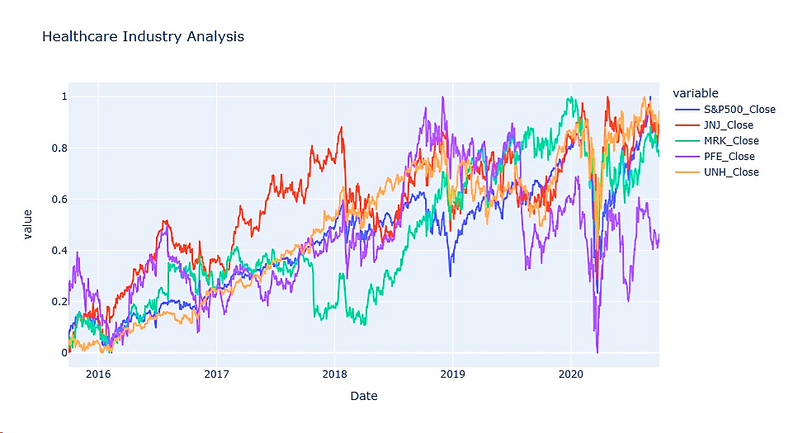
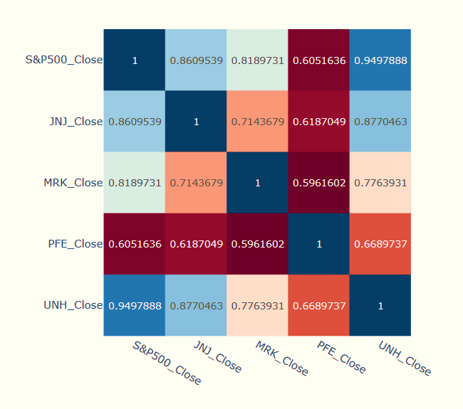
HEALTHCARE INDUSTRY ANALYSIS
The Healthcare sector faced adversity during the March 2020 Coronavirus pandemic outbreak, yet it has shown significant recovery since then.
With the exception of PFE, all other stocks within the Healthcare sector have rebounded and closely track the movements of the market index.

Slide 12
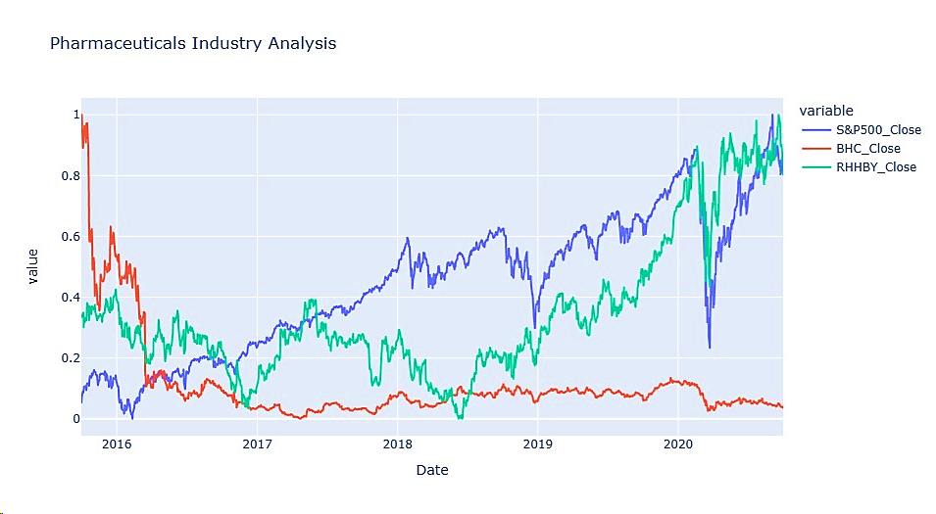
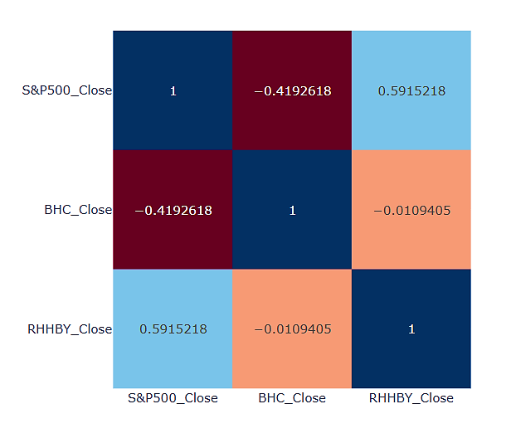
PHARMACEUTICALS INDUSTRY ANALYSIS
The Pharmaceutical sector experienced challenges during the March 2020 Coronavirus pandemic outbreak; however, it has since undergone substantial recovery.
Within the sector, Bausch Health has consistently exhibited lower performance compared to RHHBY over the years.

Slide 13
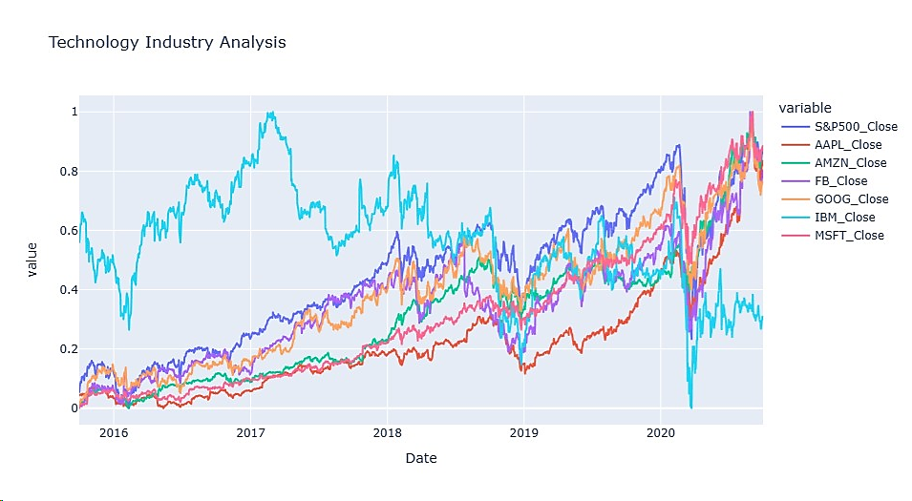
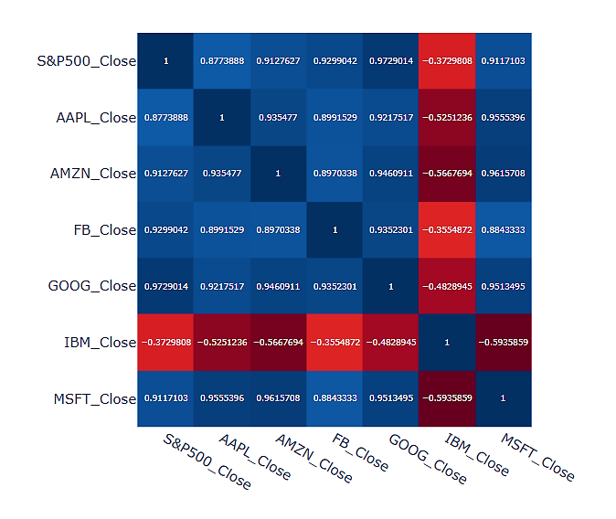
TECHNOLOGY INDUSTRY ANALYSIS
Despite facing a crisis during the March 2020 Covid pandemic, the Technology Sector has showcased remarkable recovery.
Notably, Microsoft, Amazon, Apple, Facebook, and Google have exhibited robust performance, aligning closely with the market index.
Conversely, IBM has consistently lagged behind other stocks in the same sector over the years, demonstrating underperformance.

Slide 14
Annual Returns for Stocks
Aviation
Finance
Healthcare
Pharmaceuticals
Technology
Annual Returns:
American Airlines Group Inc : -8.47%
Allegiant Travel Company : -1.19%
Alaska Air Group Inc :
- 6.44%
Delta Air Lines Inc : 1.05%
Hawaiian Holdings Inc : 0.86%
Southwest Airlines Co : 6.16%
Annual Returns:
Morgan Stanley : 14.55%
Credit Suisse :
-11.01%
Deutsche Bank :
-13.33%
Goldman Sachs : 7.64%
Wells Fargo :
-10.44%
Annual Returns:
Johnson & Johnson : 11.35%
Merck and CO inc. : 12.88%
Pfizer Inc. : 5.25%
UnitedHealthGroup Inc : 23.72%
Annual Returns:
Bausch Health Companies inc. :
-22.60%
Roche Holding AG :
7.38%
Annual Returns:
Amazon : 40.59%
Microsoft : 34.95%
Apple : 33.32%
Facebook : 26.45%
Google : 21.02%
IBM : -0.04%

Slide 15
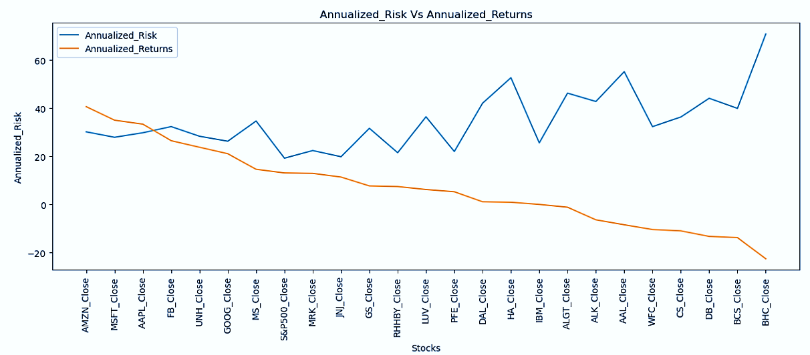
ANNUALIZED RETURNS & RISK
13 out of 26 stocks are displaying positive cumulative returns, indicating that approximately half of the stocks are yielding losses.
Seven stocks are outperforming the market index S&P500, albeit with a slightly higher level of risk.
It is evident that all technology domain stocks, excluding IBM, are generating high returns, albeit with a risk level exceeding 20.
Amazon demonstrates strong performance with high returns and a risk of 30.11.
Conversely, Bausch Health Companies Inc. (BHC) exhibits poor performance with negative 22.60% returns and a high risk of 70.72.

Slide 16
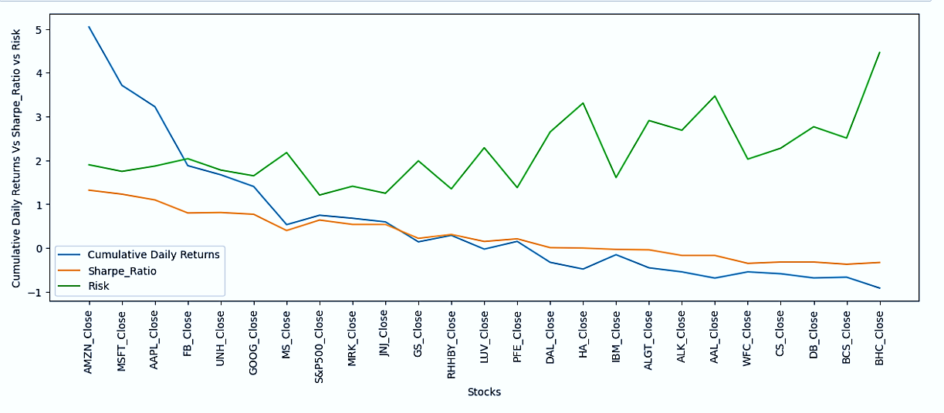
Analyzing Cumulative Daily Returns, Sharpe Ratio, and Risk
Elevated Sharpe ratios signify superior risk-adjusted performance, while negative values indicate that returns may not adequately compensate for associated risks.
AMZN (1.32), MSFT (1.23), and AAPL (1.10) exhibit positive Sharpe ratios exceeding 1, indicating that these stocks have delivered returns surpassing the risk-free rate relative to the level of risk undertaken.
Nearly half of the stocks display negative Sharpe ratios, implying that their returns fail to adequately offset the inherent risks associated with those investments.

Slide 17

Stocks to focus
High Returns
Negative Returns
Amazon, Microsoft, and Apple are generating exceptionally high returns
JNJ, RHHBY, PFE, and MRK stocks exhibit moderate risk levels while delivering decent returns
Close to half of the stocks are yielding negative cumulative returns.

Slide 18
PORTFOLIO ANALYSIS

Slide 19

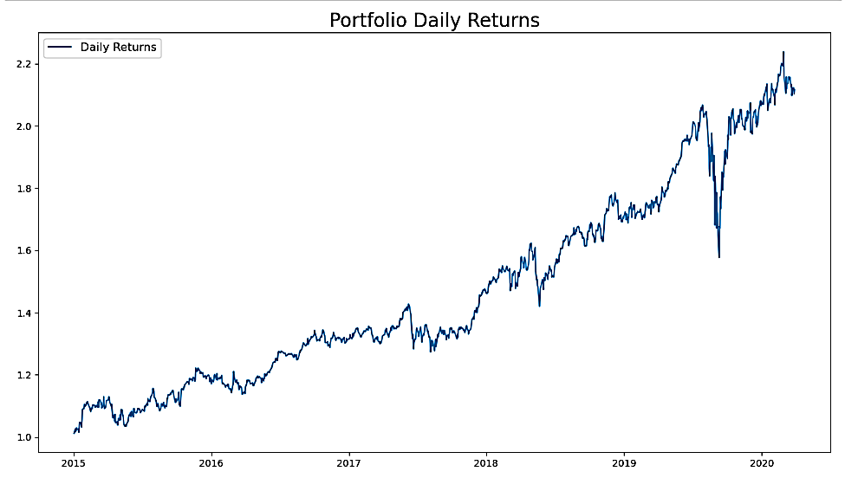


MR. PATRICK JYENGAR PORTFOLIO
ROI
Mr. Patrick Jyengar’s expected 5-year Return on Investment (ROI) of $558.23 thousand, expecting his equity investment of $500,000 to grow to $1.05 million.
Achieving this ROI reflects significant appreciation in the value of his investment, aligning with his financial goals.
Portfolio Stocks
Considering his conservative investment approach, Mr. Patrick Jyengar is contemplating the inclusion of low-risk stocks such as JNJ, RHHBY, MRK, and MSFT to diversify his portfolio.
Equal distribution of capital among the stocks is permitted in constructing the portfolio.
Risk
The calculated risk of this portfolio is 18.00, whereas the risk of the S&P500 index stands at 19.
This suggests that the portfolio has been effectively constructed with lower risk compared to the market index, indicating a favorable outcome.

Slide 20
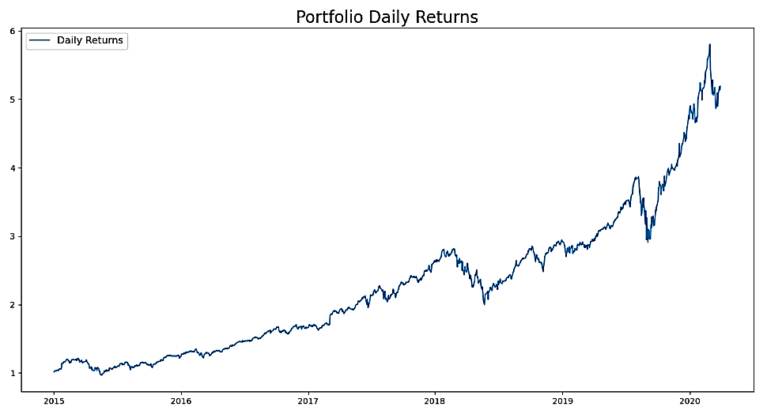
MR. PETER JYENGAR PORTFOLIO
ROI
After investing $1 million in equities, Mr. Peter Jyengar anticipates a 5-year Return on Investment (ROI) of over $4.1 million, resulting in a total portfolio value of $5.189 million. Achieving this ROI reflects significant appreciation in the value of his investment, aligning with his financial goals.
Portfolio Stocks
In line with his risk-tolerant approach, Mr. Peter Jyengar has opted for high-return investments, selecting stocks such as AMZN, AAPL, and MSFT for his portfolio.
Equal distribution of capital among the stocks is permitted in constructing the portfolio.
Risk
Mr. Peter's portfolio carries a risk rate of 25.6, reflecting his consistent adherence to a risk-tolerant approach, where he prioritizes high-return investments.
This portfolio is expected to yield returns four times the initial investment amount, reflecting Mr. Peter's high risk tolerance.

Slide 21
METHODOLOGY

Slide 22
Data Cleaning with Python:
Employed Python for systematic data cleaning and preprocessing, identifying 411 null values in FB_close and FB_volume data fields.
Concluded that the missing data was non-random, attributed to Facebook's stock listing on May 18, 2012, and subsequently imputed null values with zeros for further analysis.
Performed outlier analysis on the dataset to detect and assess data points exhibiting substantial deviations from the general pattern
Exploratory Data Analysis (EDA):
Utilized diverse calculations such as daily and cumulative returns, Sharpe ratios, portfolio risk, and ROI for thorough analysis of stock data.
Identified top-performing stocks for different portfolios based on rigorous assessment of performance metrics.
Utilized Python libraries including Matplotlib, Seaborn, and Plotly for exploratory data analysis (EDA) and visualization purposes.
Key Insights from Data Analysis:
Half of the stocks, specifically 13 out of 26, are exhibiting positive cumulative returns, implying that the remaining half are generating losses.
Seven stocks are surpassing the performance of the market index S&P500, albeit with a slightly elevated level of risk.
AMZN (1.32), MSFT (1.23), and AAPL (1.10) showcase positive Sharpe ratios exceeding 1, signifying that these stocks have provided returns surpassing the risk-free rate in proportion to the level of risk assumed.

Slide 23

Summary
This project delved into stock prices across various sectors, analyzing historical data and trading volumes for each stock. We explored daily returns and correlations, with Microsoft and Amazon showing notable correlation. We observed a maximum 8% daily price fluctuation and highlighted the importance of understanding market dynamics to manage risks. Identifying stocks with favorable risk-return profiles, Amazon emerged as high risk and high return. Ultimately, our analysis facilitated the provision of tailored portfolios for two clients, aligning with their financial objectives and risk tolerance.

Slide 24
Thank you

